Slide 1


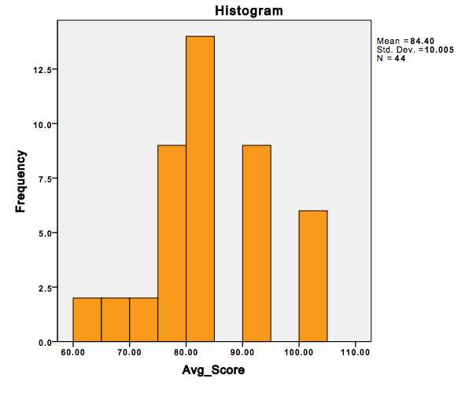
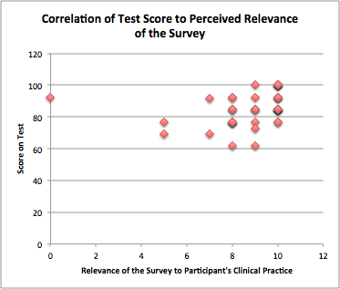
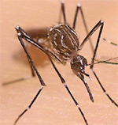
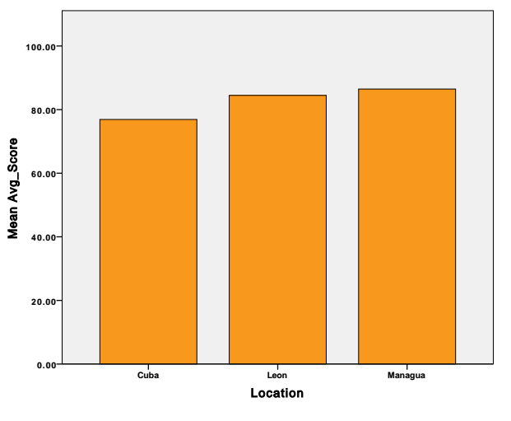
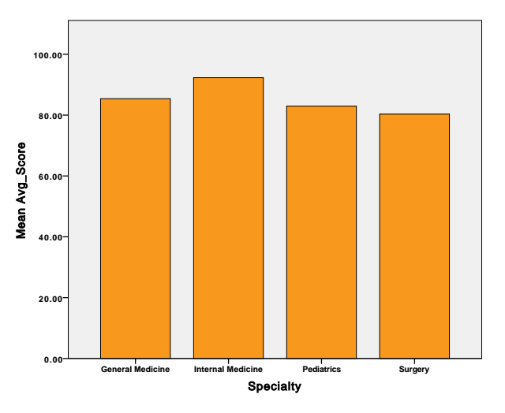
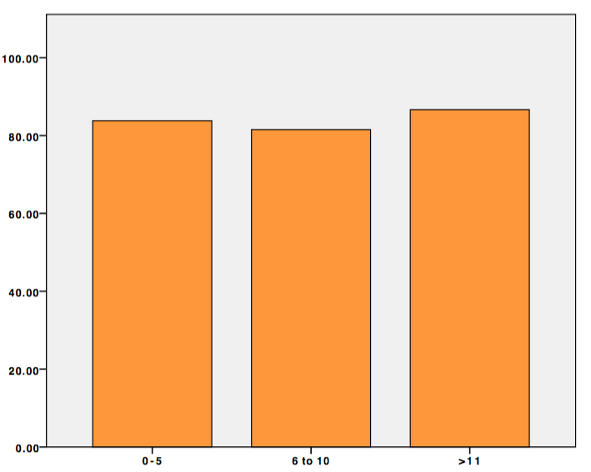
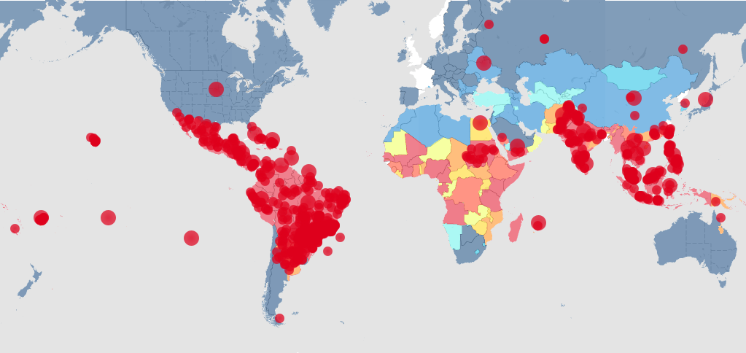

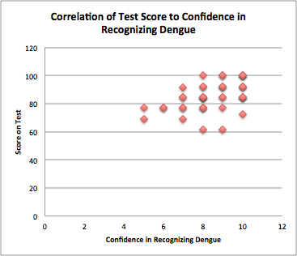
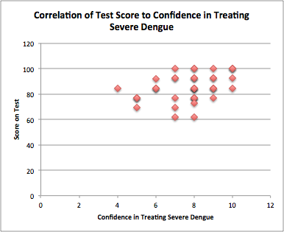
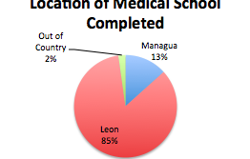

Assessment of Knowledge of Dengue in Nicaraguan Physicians
S. Han¹, L. Jacobs¹, N. Gundacker¹, F. Scott¹, A. Chang², N. Rivera ¹, D. Copenhaver, MD MPH¹
¹University of California, Davis School of Medicine, Sacramento, CA, USA,
²University of Miami, Miller School of Medicine, Miami, FL, USA
Introduction
Methods
Average Score Among All Participants
Figure 6b. Correlation of Test Score to Perceived Relevance of the Survey Content to the Community Practice. The participants rated the relevance of the information contained in the survey as 8.9 out of 10 on average, with a standard deviation of 1.3. Their relevance rating compared to their test score showed a significant positive correlation (Pearson correlation, r= 0.480, p < 0.01).
Dengue is one of the most prevalent mosquito-borne diseases of human throughout the tropics and subtropics worldwide. Over the past decade, the number of dengue outbreaks has drastically increased with more than 390 million dengue viral
Infection every year, of which 96 million manifest
clinically [1]. Dengue fever (DF) is an acute infection by
Dengue virus (DENV type 1-4) and all types are capable
of causing the full spectrum of clinical manifestation
from an asymptomatic infection to life-threatening illness
including Dengue Hemorrhagic Fever (DHF) and Dengue Shock Syndrome (DSS) [2]. Although Dengue vaccine has been introduced in 2015, global licensure is yet to be established and the level of performance and safety of the vaccine is uncertain. [3]. Prompt case recognition and appropriate clinical management of this complex disease by physicians are be crucial in reducing mortality from severe dengue complications [4].
UC Davis medical students conducted a cross-sectional study assessing knowledge of basic science, clinical presentation, diagnosis, and management of Dengue fever among Nicaraguan doctors in Leon, Granada, Totogalpa, and Sabana Grande, Nicaragua in 2014 and 2015. Participants filled out a 22-questions survey in Spanish, which was made up of multiple choice, true/false, and rating questions. Interpreters assisted with the study in order to ensure clear communications between the researchers and participants. A total of 45 participants were surveyed. Data were analyzed using SPSS.
# of participants
Figure 4a.
r = 0.480**
Average score (%)
Average Score by Location of Medical Education, Specialty, and Years of Experience
Conclusions
Score in Percentage
76.90
84.47
86.47
85.4
92.3
82.94
80.32
83.82
81.52
86.65
Discussion
The mean test score for Dengue knowledge was higher than expected, suggesting that the Nicaraguan doctors have an adequate knowledge of Dengue fever.
Knowledge base was adequate in all across topics including microbiology, pathophysiology, clinical manifestation, diagnosis, and treatment.
Physicians in Nicaragua had a high self-awareness of their Dengue knowledge.
Participants rated the clinical relevance of the survey questions highly, suggesting that this study design is useful for evaluating Dengue knowledge of physicians.
The survey had 22 questions including questions on demographics, physician confidence in recognizing and treating Dengue, and and 13 of those questions were designed to assess Dengue
knowledge.
Assessment of Knowledge on Dengue
Micro:
Q4,5,6
Treatment:
Q 8, 10, 11,13
Diagnostic test:
Q14,16,17
Pathophysio& Clinical sx recognition
Q 7, 9,12,
Location of Medical Education
Specialty
Years of Experience
Figure 4b-d.
Figure 4. (4a) The mean test score for the 13 questions assessing Dengue knowledge was 84.7% with a standard deviation of 10.2%. (4b) Mean scores were very similar between participants from all training locations. (4c) Mean scores did not vary significantly between the different specialties surveyed. (4d) There was no significant difference in mean score between physicians who had been practicing for 0 to 5 years, 6 to 10 years, or 11 or more years since graduation from medical school.
  Future Direction
Consider conducting the survey in other endemic countries to compare knowledge of Dengue
Perform this survey based study in physicians practicing in the US since Dengue Fever incidence is on the rise and evidence of Dengue outbreak is Hawaii, US.
Limitations
Smaller power due to the sample size
Many of the participants were practicing in the hospital affiliated with UNAN medical school, which is a teaching hospital. May not represent the knowledge base in clinics across Nicaragua
Figure 1. Aedes aegypti and
Dengue World Map
Figure 2.Categories of 13 Questions Asked with the Corresponding Number of Question on the Survey
Results
In the survey conducted by in Puerto Rico, only 29% of physician respondents correctly identified early signs of shock and 48% identified the warning signs for severe dengue [5]. Similar to those DF endemic countries, Nicaragua is reported to have a high incidence of dengue virus infection of 6-29% per year [6]. However, there is a lack of studies on assessment of Dengue knowledge in physicians in Nicaragua.
Figure 5. Average Test Score for Different Category of Dengue Questions. Participants demonstrate a mean score of 93.2% for knowledge of microbiology, 84.4% for pathophysiology clinical presentation, 77.9% for diagnostic tests, and 83.5% for treatment.
References
*Images used for figure 1 were obtained from http://www.cdc.gov/dengue/
1. Bhatt S, Gething PW, Brady OJ, Messina JP, Farlow AW, Moyes CL et al. The global distribution and burden of dengue. Nature. 2014; 496:504-507
2. Gibbons RV and DW Vaughn. (2002) Dengue: an escalating problem. BMJ. 2002; 324 (7353):1563-6.
3. Carvalho A, Roy RV, and Jon Andrus. International Dengue Vaccine Communication and Advocacy: Challenges and Way Forward. Expert Rev Vaccines. 2016; [Epub ahead of print].
4. Murray NE, Quam MB, and Annelies Wilder-Smith. Epidemiology of dengue: past, present and future prospect4. Clin Epidemiol. 2013; 5:299-309.
5. Tomashek KM, Biggerstaff BJ, Ramos MM, Perez-Guerra CL et al. Physician survey to determine how Dengue is diagnosed, treated and reported in Puerto Rico. PLoS Negl Trop Dis. 2014; 8:e3192.
6. Guzman MG and Eva Harris. Dengue. Lancet. 2015; 385:453-65.
Research Objectives
Purpose of this study was to assess Dengue knowledge among doctors practicing in Nicaragua, a Dengue endemic country. Based on the studies done in Puerto Rico, we expect Dengue knowledge to be inadequate.
r = 0.474**
r = 0.388*
Figure 6a. Correlation Between Test Score and Confidence Rate on Dengue Recognition and Treatment.
When the self-reported confidence rate was correlated with the individual’s test score, there was a significant positive correlation for both confidence in Dengue recognition and treatment. (Pearson correlation, r= 0.474, p < 0.01; Pearson correlation, r= 0.388, p < 0.05).
The mean participant confidence in recognizing Dengue was 8.4 out of 10 with a standard deviation of 1.4, and mean confidence in treating a severe case of Dengue was 7.7 with a standard deviation of 1.52. (Not shown in figure)
Acknowledgements
Figure 3. Participant Demographics. Majority of the participants were practicing in general medicine, trained in Leon, have been practicing medicine for less than 5 years, and had seen more than or equal to 10 cases of Dengue.
The study was approved by the IRB at UC Davis and the Director of the UNAN-Leon medical school.
Funding provided by Medical Student Research Fellowship
Special thanks to our Interpreters- Kyle Kim, Lisa Maria Geronimo, Alejandra Beristain-Barajas, and Andrea Araujo Ferrer.

